Slide 1
Constructing triangles
Constructions

Slide 2
how to use Oak lessons

Slide 3
I can use intersecting circles to construct triangles from given lengths.

Slide 4
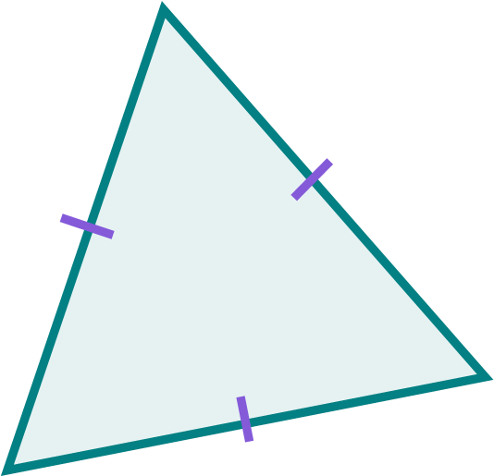
Scalene triangles have three different-sized angles and three edges of different lengths.
Isosceles triangles have two equal-sized angles. Two of the edges are equal in length.
Equilateral triangles have three equal-sized angles and three edges of equal length. They are regular triangles.
The radius is any line segment that joins the centre of a circle to any point on its circumference.

Slide 5

Constructing triangles
Constructing a scalene triangle
Constructing triangles with equal edges

Slide 6
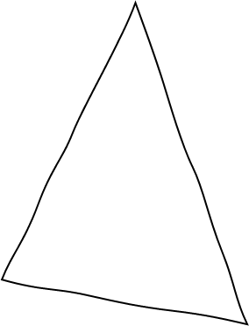
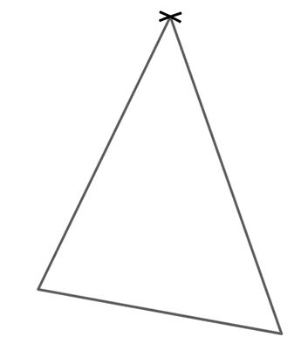
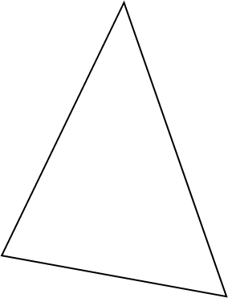
Constructing a scalene triangle
At times we might need to draw a shape. The situation determines the level of accuracy and detail that is needed.
freehand sketch
construction
drawing
geometry equipment used and drawn accurately
no equipment has been used other than a pencil
pencil and ruler used but not drawn accurately

Slide 7
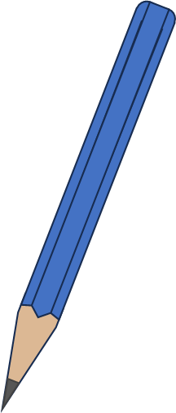
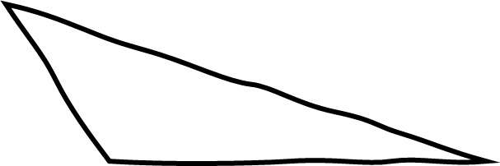
Constructing a scalene triangle
Lucas is attempting to construct this triangle with a ruler and pencil.
C
9 cm
4 cm
B
A
x C
6 cm
He first draws AB using his ruler and pencil.
Then he marks vertex C, 9 cm from vertex B.
A
B
6 cm
But … it isn’t 4 cm from A!

Slide 8
Constructing a scalene triangle
Lucas is attempting to construct this triangle with a ruler and pencil.
C
9 cm
4 cm
B
A
x C
x C
6 cm
x C
x C
x C
x C
x C
He makes further attempts …
A
B
6 cm

Slide 9
Constructing a scalene triangle
Lucas is attempting to construct this triangle with a ruler and pencil.
C
9 cm
4 cm
B
A
x C
x C
6 cm
x C
x C
x C
x C
x C
But none of them are 4 cm from A!
x C
x C
x C
A
B
6 cm

Slide 10
Constructing a scalene triangle
Lucas is attempting to construct this triangle with a ruler and pencil.
C
9 cm
4 cm
B
A
x C
x C
6 cm
x C
x C
x C
x C
x C
Finally he finds a point that is 9 cm from B and 4 cm from A.
x C
x C
x C
x C
A
B
6 cm

Slide 11
Constructing a scalene triangle
Lucas is attempting to construct this triangle with a ruler and pencil.
C
9 cm
4 cm
B
A
6 cm
He joins vertex C to the ends of the line segment AB to finish the construction.
x C
9 cm
4 cm
A
B
6 cm

Slide 12
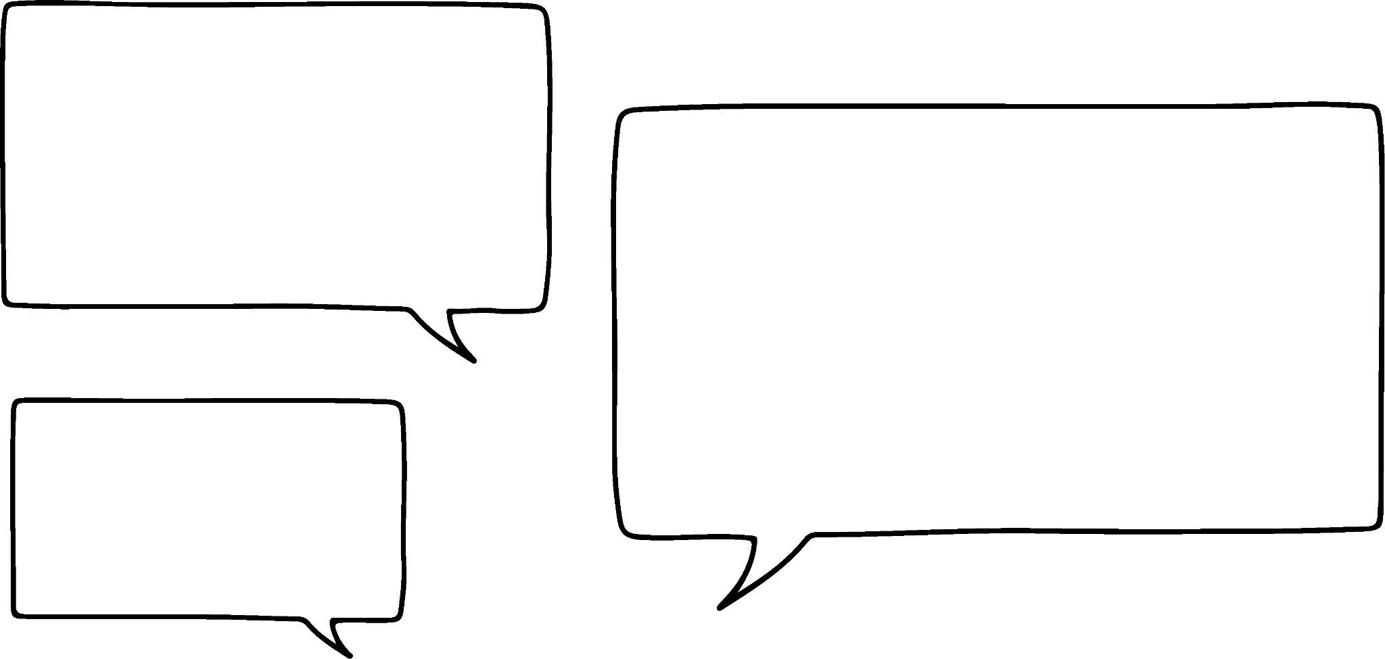

Constructing a scalene triangle
Lucas is attempting to construct this triangle with a ruler and pencil.
C
9 cm
4 cm
B
A
x C
x C
6 cm
x C
x C
x C
x C
My attempts have created an arc,
x C
x C
x C
x C
x C
9 cm
which makes sense as they are all a fixed distance from B.
x C
4 cm
A
B
6 cm

Slide 13
Constructing a scalene triangle
Lucas is attempting to construct this triangle with a ruler and pencil.
C
9 cm
4 cm
B
A
6 cm
Another circle from A shows the location of point C. Although, I think there is somewhere else it could go?
x C
9 cm
4 cm
A
B
4 cm
6 cm
9 cm
x C

Slide 14
Constructing a scalene triangle
Lucas is attempting to construct this triangle with a ruler and pencil.
C
9 cm
4 cm
B
A
6 cm
It’s just a reflection of the sketched triangle; it still has the correct length of edges.
x C
9 cm
4 cm
A
B
4 cm
6 cm
9 cm
x C

Slide 15
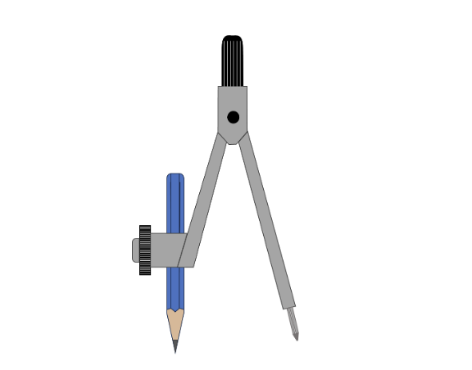
Constructing a scalene triangle
Constructing a triangle with a pencil and ruler is quite challenging to be accurate and find the exact location of the third vertex in a timely fashion.
As we just saw, using circles to locate the third vertex is much more efficient.
What equipment helps to draw accurate circles?
A pair of compasses

Slide 16
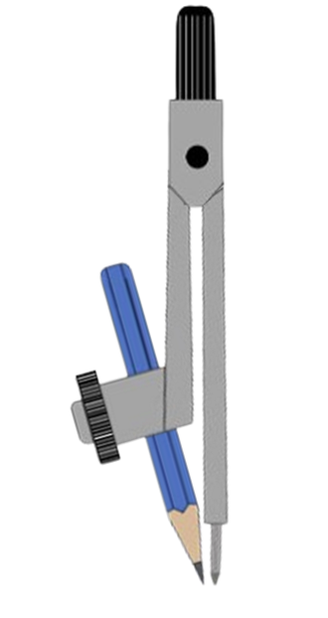
Constructing a scalene triangle
Before we start any construction, we need to prepare our equipment.
You will need to have a sharp (ideally short) pencil, a tightened pair of compasses and a ruler.
Then set up your pair of compasses by making sure the pencil tip is level with the needle point, when the legs of the pair of compasses is together, like in the image here.

Slide 17
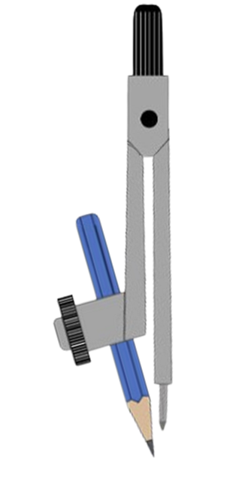


Constructing a scalene triangle
Which of these is the best set up of a pair of compasses?
pencil and needle tips not level
blunt pencil

Slide 18
Constructing a scalene triangle
Let us construct triangle PQR, where PQ = 7 cm, PR = 9 cm and QR = 10 cm
To support us with this, it is helpful to do a quick sketch of the triangle.
P
9 cm
Now, we can start the construction.
7 cm
R
10 cm
Q
10 cm
7 cm
9 cm

Slide 19
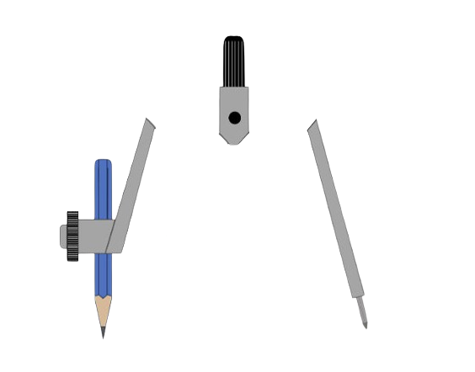
Constructing a scalene triangle
Let us construct triangle PQR, where PQ = 7 cm, PR = 9 cm and QR = 10 cm
To support us with this, it is helpful to do a quick sketch of the triangle.
P
9 cm
Now, we can start the construction.
7 cm
R
10 cm
Q
Q
R
10 cm
7 cm
9 cm

Slide 20
Constructing a scalene triangle
Let us construct triangle PQR, where PQ = 7 cm, PR = 9 cm and QR = 10 cm
To support us with this, it is helpful to do a quick sketch of the triangle.
P
9 cm
7 cm
R
10 cm
Q
Q
R
10 cm
7 cm
9 cm

Slide 21
Constructing a scalene triangle
Let us construct triangle PQR, where PQ = 7 cm, PR = 9 cm and QR = 10 cm
To support us with this, it is helpful to do a quick sketch of the triangle.
P
9 cm
7 cm
R
P
10 cm
Q
7 cm
9 cm
Connect the three vertices to finish the construction.
Q
R
10 cm
7 cm
9 cm

Slide 22
Constructing a scalene triangle
Let us construct triangle PQR, where PQ = 7 cm, PR = 9 cm and QR = 10 cm
To support us with this, it is helpful to do a quick sketch of the triangle.
P
9 cm
7 cm
R
10 cm
Q
Connect the three vertices to finish the construction.
Q
R
10 cm
7 cm
9 cm
7 cm
9 cm
P

Slide 23
Constructing a scalene triangle
Mark where the three vertices of the triangle are, using this construction.
or

Slide 24
Constructing a scalene triangle
1) Construct this triangle accurately.
2) Construct the triangle with edge lengths 6 cm, 8 cm and 10 cm.
11 cm
6 cm
7 cm

Slide 25
Constructing a scalene triangle
3) Construct triangle ABC, where AB = 12 cm, BC = 13 cm and AC = 50 mm.
4) Construct the scalene triangle that has an edge of 6 cm, an edge of 7 cm and a perimeter of 23 cm.
5) Construct a scalene triangle with a perimeter of 180 mm.

Slide 26
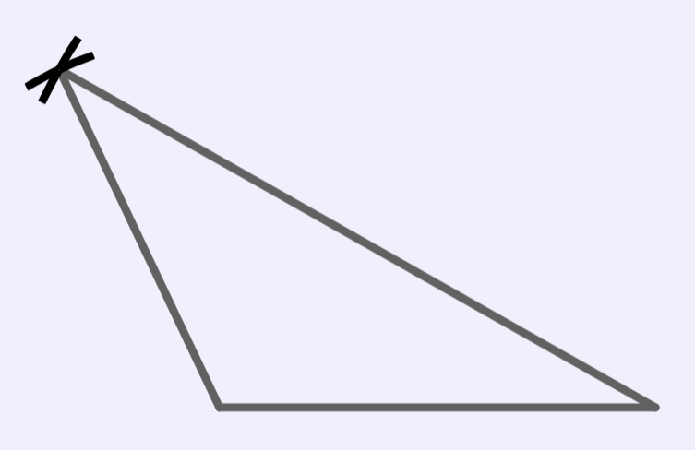
Constructing a scalene triangle
1) Construct this triangle accurately
11 cm
6 cm
7 cm
11 cm
To check your accuracy, measure the marked angles with a protractor.
6 cm
115°
30°
7 cm

Slide 27
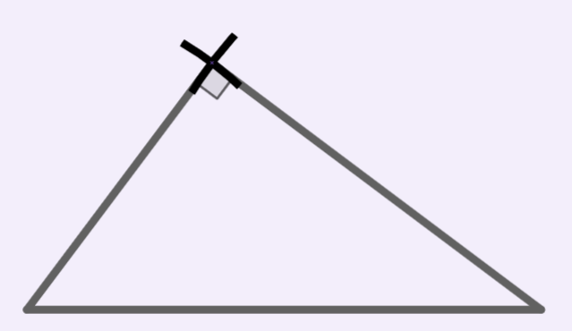
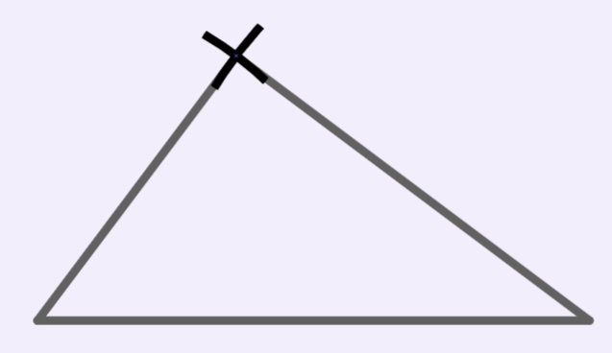
Constructing a scalene triangle
2) Construct the triangle with edge lengths 6 cm, 8 cm and 10 cm.
The angle between the 6 cm edge and the 8 cm edge should be 90°.
Use a protractor to check it.
8 cm
6 cm
10 cm

Slide 28
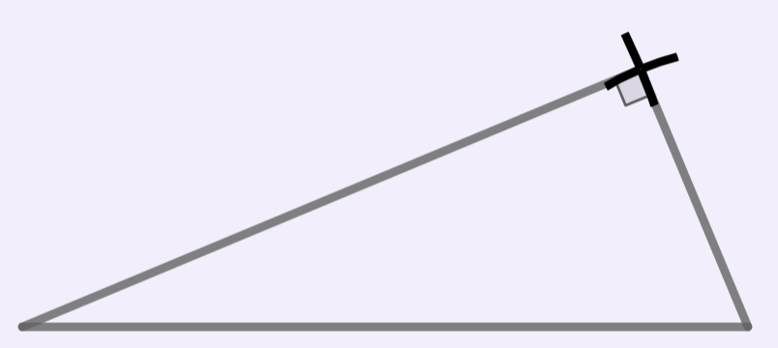
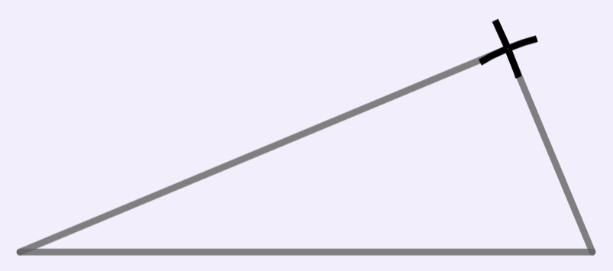
Constructing a scalene triangle
3) Construct triangle ABC, where AB = 12 cm, BC = 13 cm and AC = 50 mm.
The angle between AB and AC should be 90°.
Use a protractor to check it.
A
12 cm
5 cm
B
C
13 cm

Slide 29
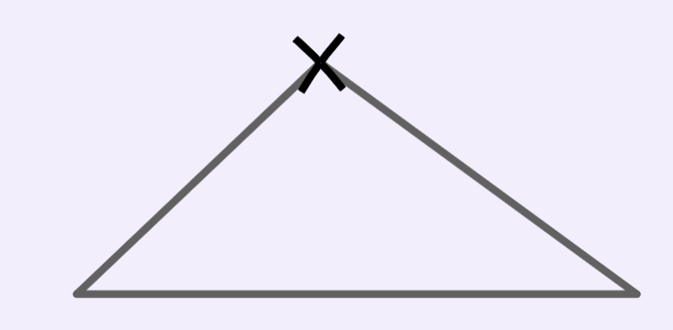
Constructing a scalene triangle
4) Construct the scalene triangle that has an edge of 6 cm, an edge of 7 cm and a perimeter of 23 cm.
If the perimeter is 23 cm and two of the edges sum to 13 cm, then the third edge will need to have a length of 10 cm.
To check your accuracy, measure the marked angles with a protractor.
7 cm
6 cm
44°
36°
10 cm

Slide 30
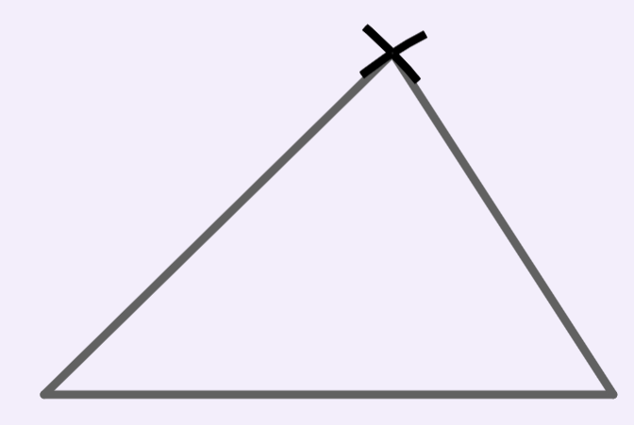
Constructing a scalene triangle
5) Construct a scalene triangle with a perimeter of 180 mm.
An example of a correct answer:
60 mm
50 mm
70 mm

Slide 31
Constructing triangles
Constructing a scalene triangle
Constructing triangles with equal edges

Slide 32

Constructing triangles with equal edges
Aisha has been asked to construct an isosceles triangle, with edge lengths 7 cm, 7 cm and 5 cm.
What edge should she draw with her ruler?
For efficiency, she should draw the base edge, then she only needs to set her pair of compasses once.
7 cm
7 cm
5 cm
7 cm

Slide 33
Constructing triangles with equal edges
As we only use one of the point of intersection, we do not need to draw the full circles, we can draw arcs instead.
Here is Aisha’s construction with arcs instead of full circles.
7 cm
7 cm
5 cm
7 cm

Slide 34
Constructing triangles with equal edges
What is the next step in the construction?
Mark the third vertex and then form the triangle using line segments.

Slide 35
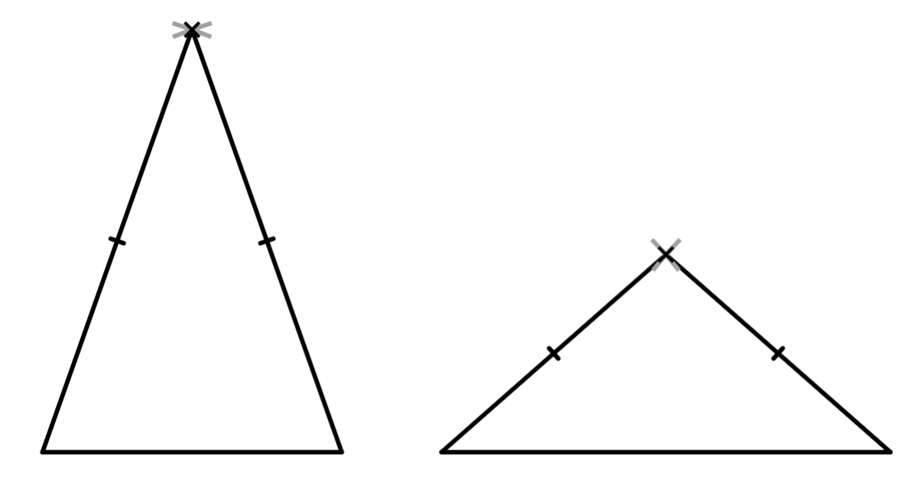


Constructing triangles with equal edges
Jacob and Jun have both constructed an isosceles triangle with edges of 6 cm and 9 cm.
9 cm
6 cm
6 cm
9 cm
We need to be careful when constructing isosceles triangles that could be drawn in two different ways.

Slide 36

Constructing triangles with equal edges
Izzy has been tasked with constructing an isosceles triangle where the equal edges are 8 cm. She doesn’t have any other information.
She draws one of the 8 cm edges.
Then she draws an arc for the other 8 cm edge.
There are lots of possibilities for an isosceles triangle with equal edges of 8 cm.
8 cm

Slide 37
Constructing triangles with equal edges
Izzy has been tasked with constructing an isosceles triangle where the equal edges are 8 cm. She doesn’t have any other information.
She draws one of the 8 cm edges.
8 cm
8 cm
8 cm
Then she draws an arc for the other 8 cm edge.
8 cm
There are lots of possibilities for an isosceles triangle with equal edges of 8 cm.
8 cm

Slide 38
Constructing triangles with equal edges
If we can construct scalene and isosceles triangles, then we can construct an equilateral triangle as well.
By definition an equilateral triangle has equal edges; it is a regular triangle.
We can set up the pair of compasses using the base edge.
7 cm
7 cm
7 cm

Slide 39
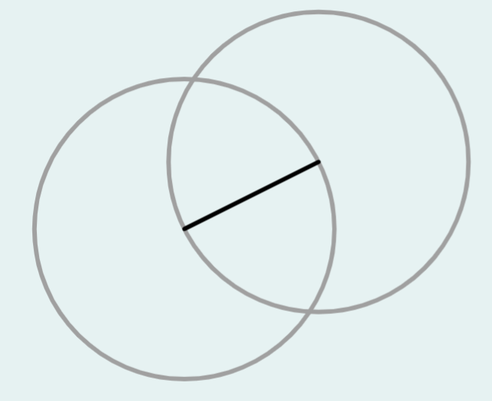
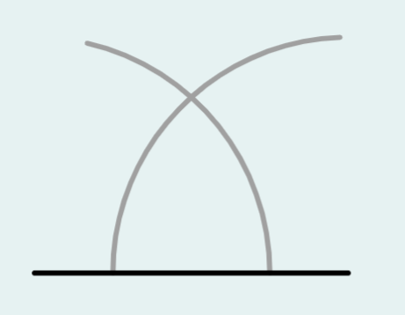
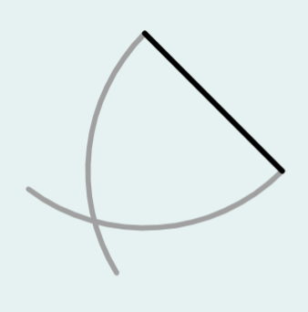
Constructing triangles with equal edges
Which of the following partial constructions would not complete to make an equilateral triangle?

Slide 40
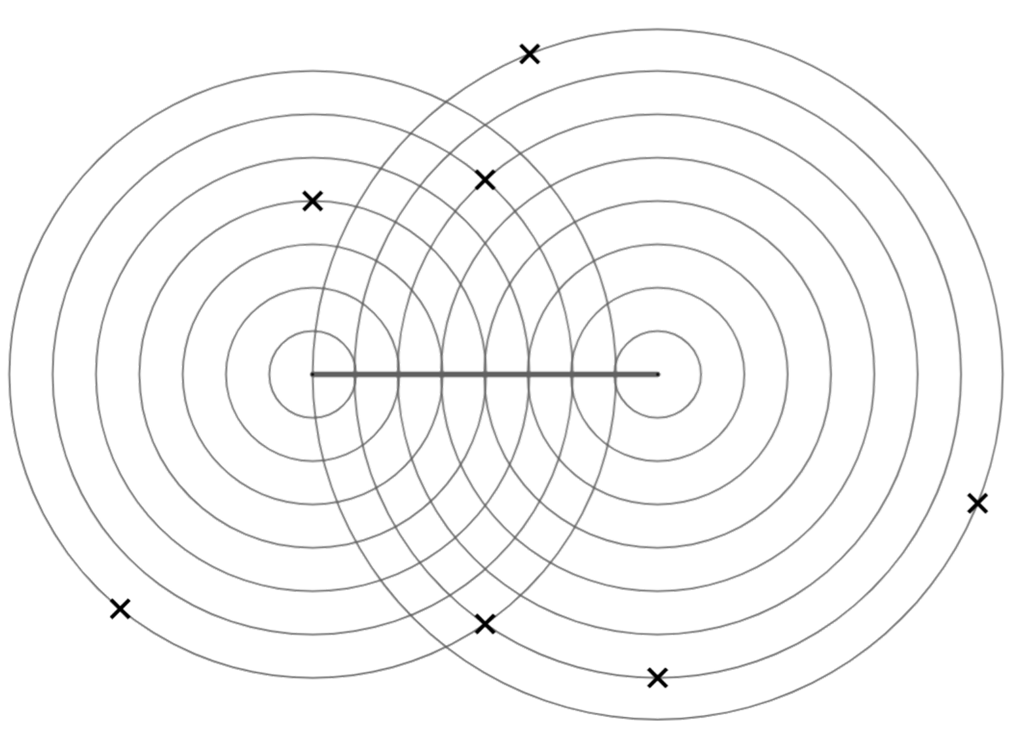
Constructing triangles with equal edges
1) XY is an edge of a triangle. Which of the points A to G when joined to XY would create:
a) an isosceles triangle
b) a right-angled triangle
c) a right-angled isosceles triangle
C
A
B
X
Y
D
G
F
E

Slide 41
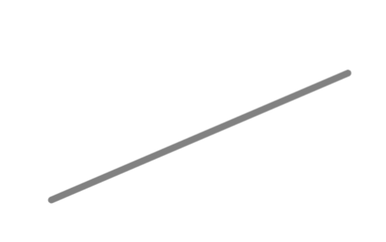
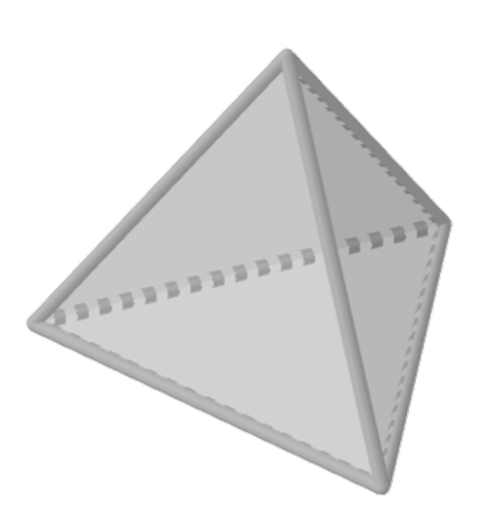
Constructing triangles with equal edges
2) Construct an equilateral triangle, using the line as one of the edges.
3) Construct an isosceles triangle where the equal edges are 9 units and the base edge is 7 units. Use this scale.
4) A tetrahedron is a 3D shape with four equilateral triangular faces. Construct the net of a tetrahedron.

Slide 42
Constructing triangles with equal edges
1) XY is an edge of a triangle. Which of the points A to G when joined to XY would create:
a) an isosceles triangle
b) a right-angled triangle
c) a right-angled isosceles triangle
C
B, C, D, F
A
B
A and E
X
Y
D
G
F
there isn’t one
E

Slide 43
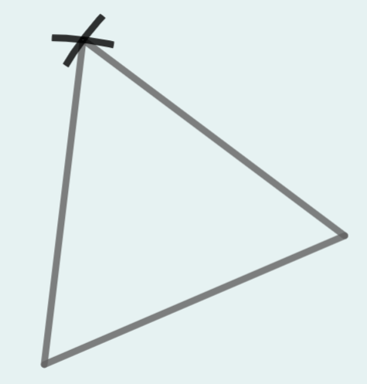
Constructing triangles with equal edges
2) Construct an equilateral triangle, using the line as one of the edges.
You can check your angles with a protractor; they should all be 60°

Slide 44
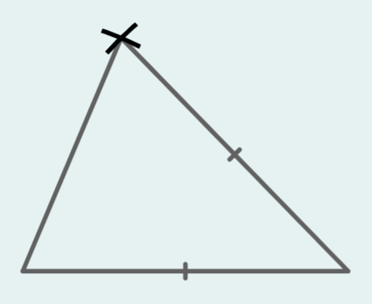
Constructing triangles with equal edges
3) Construct an isosceles triangle where the equal edges are 9 units and the base edge is 7 units. Use this scale.
Check your angles with a protractor
67°
46°

Slide 45
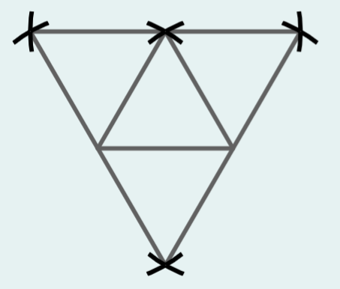
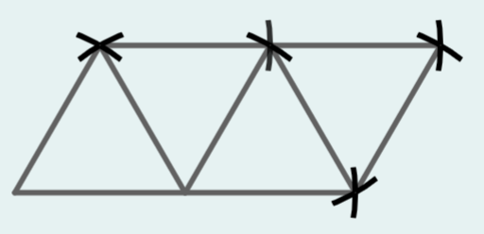
Constructing triangles with equal edges
4) A tetrahedron is a 3D shape with four equilateral triangular faces. Construct the net of a tetrahedron.
2 distinct nets of a tetrahedron

Slide 46
Constructing triangles
A construction is an accurate drawing using geometry equipment.
Intersecting circles can be used to construct triangles.
Three different radii will construct a scalene triangle.
Two different radii will construct an isosceles triangle.
Equal radii will construct an equilateral triangle.

Slide 47

© Oak National Academy 2023.
Produced in partnership with Mathematics in Education and Industry.
Licensed on the Open Government Licence v3.0, except where otherwise stated. See Oak terms and conditions.

